Slide 1
Counter Reformation
What is it?

Slide 2
Objectives
Describe the Catholic Reformation

Slide 3
Key Terms
Council of Trent

Slide 4
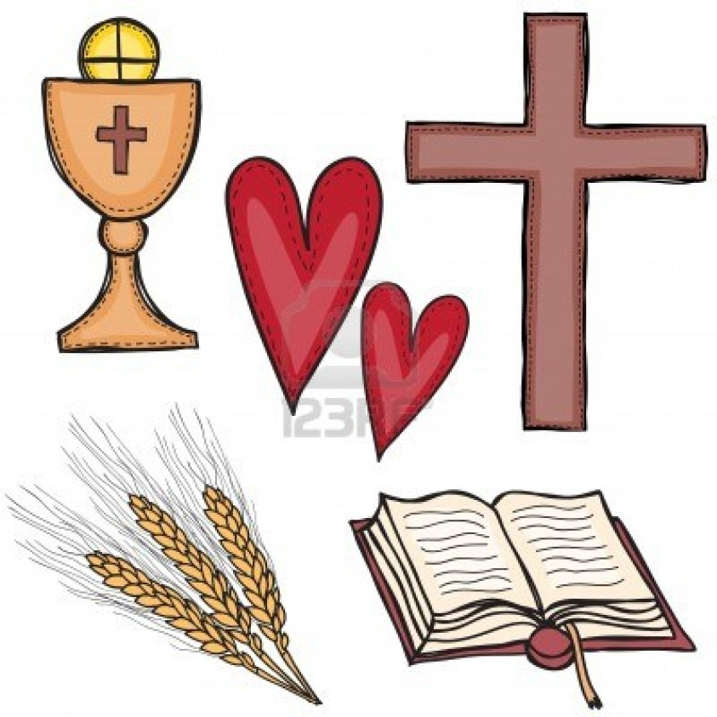
Counter Reformation
The church started a number of reforms to respond to the Protestant reformation and to strengthen and spread the Catholic religion.

Slide 5
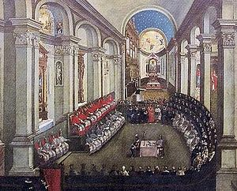
*Council of Trent*
1545, Pope meets with church leaders to deal with the problems of the church.

Slide 6
Results
Catholics were to continue to accept these principles:
Only the church could explain the Bible

Slide 7
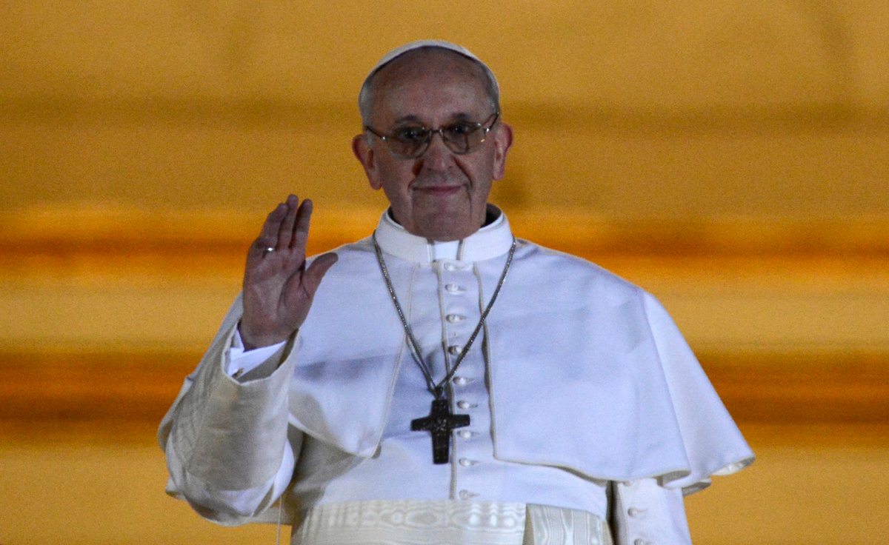
Both faith and good works were necessary for salvation
The Pope was the highest and final authority in the church

Slide 8
Church ritual was still to be an essential part of the church.
Clergy were not allowed to marry.

Slide 9
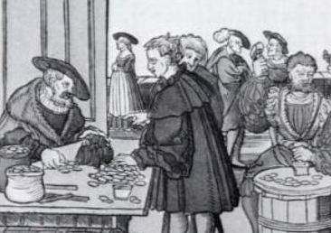
Reforms
Banned the sale of indulgences
Tightened discipline for the clergy
Only worthy people could become clergy
All clergy should be trained a seminaries
Encouraged reform of monasteries and convents

Slide 10
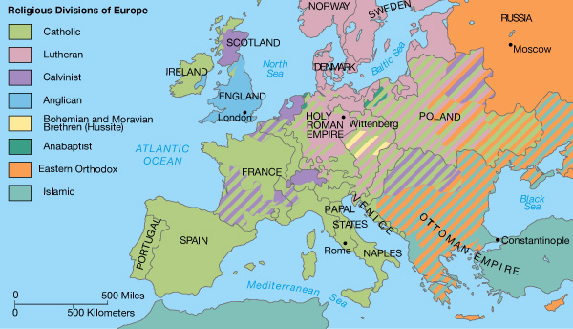
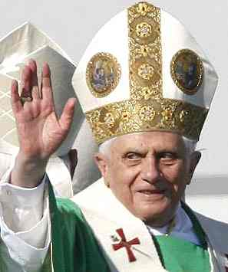
Where?
Northern Europe is mostly Protestant
Southern Catholic

Slide 11
Counter Reformation
Strengthened the state government
Protestant rulers rejected the authority of the Pope
Catholic rulers allowed the Church fewer privileges and less influence in political matters
*Persecuted religious minorities.*

Slide 12
Reformation and Counter Reformation
Both:
Spread education
Literacy important to read the Bible
Jesuits start Catholic schools and universities

Slide 13
Reformation
Strengthened the Middle Class
Protestants emphasized:
1. hard work
2. responsibility
3. upright living.

Slide 14
Objectives
Describe the Catholic Reformation
Reaction to the Protestant Reformation an attempt to get rid of corruption in the church
**major result was persecution of religious minorities**

Slide 15
Key Terms
Council of Trent
Recommended ways to reform the church

